Slide 1
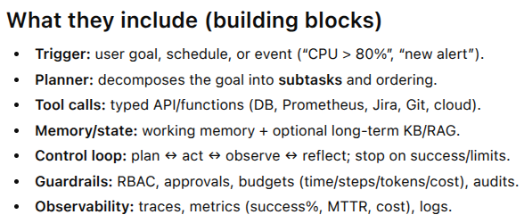

Slide 2
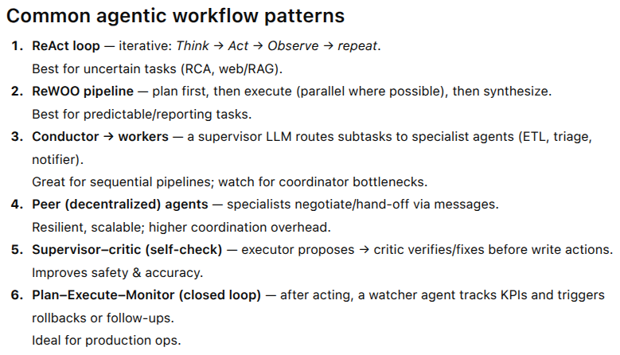

Slide 3
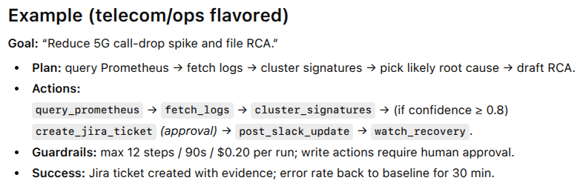

Slide 4
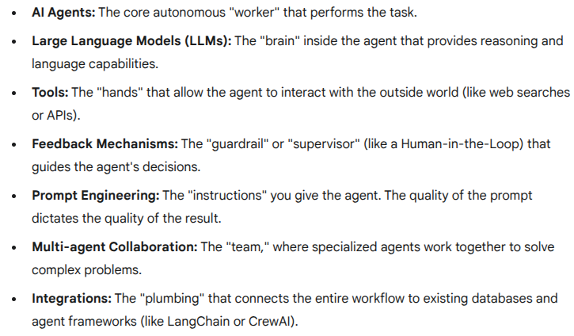
Components of agentic workflows

Slide 5
LAB - agentic_ver_1.0.tgz

Slide 6
What is AI agent communication?
Agent-to-agent communication
Human-AI communication
Any protocol for standardization ?

Slide 7
Tool Calling
Tool calling is the ability of an AI agent or Large Language Model (LLM) to use external programs, APIs, or functions to perform tasks, get information, or interact with the outside world.
Think of the AI as a very smart brain in a jar. By itself, it only "knows" the text it was trained on. It can't check the current weather, browse the internet, book a flight, or access your personal database.
Tool calling gives that brain "hands" to interact with other systems.
Refer A2A & MCP protocol slides.

Slide 8
How Tool calling Works
Tool calling (which is also often called function calling) is a multi-step process:
User Request: You ask the AI a question it can't answer on its own, like, "What's the weather in London right now and can you add a reminder for me to check it again in 3 hours?"
2. AI Identifies a Tool: The AI analyzes your request and recognizes that it needs external help. It knows it has a "tool" for getting weather and a "tool" for setting reminders.
3. AI Generates a Request: The AI doesn't run the tool itself. Instead, it generates a structured command, usually in a format like JSON, that tells the application which tool to run and what parameters to use.
It might output something like: { "tool_name": "get_weather", "location": "London, UK" }
And then: { "tool_name": "set_reminder", "task": "Check London weather", "time": "in 3 hours" }
4. Application Executes the Tool: The application (the chatbot, website, or program you're interacting with) sees this command, runs the actual code for the get_weather API and the set_reminder function, and gets the results.
5. Result is Sent Back to AI: The application takes the results (e.g., "It is 15°C and cloudy in London" and "Reminder set successfully") and feeds them back to the AI.
6. AI Formulates the Final Answer: The AI now has all the information it needs. It uses the tool's results to give you a natural language answer: "The weather in London is currently 15°C and cloudy. I've also set a reminder for you to check it again in 3 hours."

Slide 9
Common Examples of Tools
Tool calling allows an AI to go from a simple text generator to a powerful assistant. Common tools include:
Information Retrieval:
Web search: To get real-time news, facts, or sports scores.
API calls: To check stock prices, get weather forecasts, or find flight information.
Database queries: To retrieve customer information or product inventory from a private database.
Performing Actions:
Sending emails or messages.
Booking appointments or making reservations.
Controlling smart home devices (e.g., "Turn on the lights").
Running code: Executing a Python script to perform a complex calculation.
In all -
Tool calling is the key technology that makes AI agents interactive and useful in the real world, rather than just being text predictors.

Slide 10
Agentic architecture

Slide 11
An agentic architecture is a design pattern for AI systems that allows them to operate autonomously to achieve complex goals.
Instead of just responding to a single prompt (like a standard chatbot), an AI agent built with this architecture can reason, create a multi-step plan, execute actions over time, and adapt its plan based on new information—all with minimal human intervention.
It's the difference between a simple calculator (which only answers when you press a button) and a self-driving car (which perceives its environment, plans a route, and actively drives to the destination).

Slide 12
Core Components of an Agent
At its simplest, an agentic architecture consists of three key parts:
Model (The "Brain"): This is a large language model (LLM), like Gemini. It provides the core reasoning, planning, and decision-making capabilities.
2. Tools (The "Hands"): These are the external functions and APIs the agent can use to interact with the world. This is the "tool calling" you asked about earlier.
Examples include:
search_web(query)
get_weather(location)
run_python_code(script)
query_database(sql)
send_email(to, subject, body)
3. Instructions (The "Goal"): This is the set of guidelines, constraints, and the high-level objective given to the agent. This is often a "system prompt" that defines its role (e.g., "You are a senior software engineer") and its ultimate goal (e.g., "Debug this block of code and fix the bug").

Slide 13
How It Works: The Reasoning Loop
An agent operates in a continuous cycle, often called a reasoning loop, to achieve its goal:
Perceive & Plan: The agent analyzes its main goal and the current situation. It breaks the goal down into smaller, actionable steps. (e.g., Goal: "Summarize today's tech news." Step 1: Search the web for tech news.)
2. Decide (Tool Calling): The agent decides which tool is needed for the next step. (e.g., Decision: "I need to use the search_web tool.")
3. Execute: The agent calls the chosen tool with the required parameters (e.g., search_web(query="top tech news today")). The application, not the LLM, runs this code.
4. Observe & Adapt: The agent receives the result from the tool (e.g., a list of articles). It adds this new information to its memory and re-evaluates its plan. (e.g., Observation: "I have 10 articles. Step 2: Read and summarize each one. Step 3: Combine the summaries.")
5. Repeat: The agent continues this loop—planning, deciding, and executing—until it determines that the final goal has been achieved.

Slide 14
Types of Agentic Architectures
1. Single-Agent Architecture
This is the foundational design: one LLM (brain) with a set of tools, operating in a loop. It's powerful for contained tasks like research and summarization or simple automation.
2. Multi-Agent Architecture
This is a more advanced system where multiple specialized agents collaborate to solve a problem, much like a team of human experts. Common patterns include:
Orchestrator (Supervisor) Model: A "manager" agent receives the main goal, breaks it into sub-tasks, and delegates them to specialized "worker" agents (e.g., a ResearchAgent, a CodingAgent, and a ReviewerAgent).
Hierarchical System: A "CEO" agent gives a task to a "Director" agent, who breaks it down for "Manager" agents, who then use "Worker" agents.
Collaborative Network: Agents can talk to each other directly to solve a problem, like a debate or brainstorming session.

Slide 15
An Example: Agentic RAG
This concept even enhances systems like RAG (Retrieval-Augmented Generation):
Standard RAG: Takes your query, always searches a vector database, and always stuffs the results into a prompt for the LLM.
Agentic RAG: The agent decides what to do. It might first rephrase your query, then decide whether to search a vector database, a SQL database, or the web. It can then self-check the answer for quality and, if it's bad, decide to run a new, different search to get a better result.

Slide 16
What is AI agent orchestration?

Slide 17

AI agent orchestration
AI agent orchestration is the process of managing and coordinating multiple specialized AI agents to work together to achieve a complex goal.
Think of it like a human project team. Instead of one generalist trying to do everything, you have:
A project manager (the orchestrator)
A researcher (a web-browsing agent)
A coder (a code-writing agent)
A reviewer (a quality-checking agent)
Orchestration is the system that acts as the project manager, breaking down a large task (e.g., "build me a simple weather app") and intelligently assigning the sub-tasks to the right agent at the right time.

Slide 18
How It Works
Orchestration moves AI from a simple, single-response tool to an autonomous, multi-step system. The process generally follows a loop:
Task Decomposition: The main orchestrator (which can be a human or another AI agent) receives a complex goal. It analyzes the goal and breaks it down into a logical sequence of smaller, manageable tasks.
2. Agent Selection: The orchestrator identifies the best "specialized agent" for the current task. For example, if the task is to find information, it routes the request to a ResearchAgent.
3. Task Execution: The specialized agent performs its task (e.g., searches the web) and returns the result (e.g., a list of articles) to the orchestrator.
4. Coordination & Data Flow: The orchestrator takes this output and maintains it in a shared memory or "context." It then decides the next step. It might pass the list of articles to a SummaryAgent to be condensed.
5. Result Synthesis: This loop of selecting, executing, and passing data continues until all sub-tasks are complete. The orchestrator then assembles the final, comprehensive result and presents it to the user.

Slide 19
Core Components
An orchestration framework typically consists of:
Orchestrator Agent (The Conductor): The central "brain" or coordinator. It analyzes requests, plans the workflow, and directs the other agents.
Specialized Agents (The Musicians): These are individual AI agents, each with a specific role, set of tools, and instructions (e.g., BillingAgent, SupportAgent, DatabaseQueryAgent).
State Management (Shared Memory): A system for tracking the overall progress, storing results from each agent, and ensuring all agents have the context they need to work.
Communication Protocols: The "language" or set of rules that agents use to pass messages, tasks, and data to each other and to the orchestrator.

Slide 20
Common Orchestration Patterns
Not all orchestration is a simple, linear pipeline. Different patterns are used for different problems:
Sequential: The most basic pattern. Agent A finishes, hands off to Agent B, who hands off to Agent C. This is good for step-by-step processes like "research, then write, then edit."
Centralized (Supervisor): A single "supervisor" agent acts as a router. It receives all inputs and decides which specialized agent to call next. This is a very common and controllable pattern.
Decentralized: Agents can communicate directly with each other (peer-to-peer) to collaborate or negotiate on a task without a single boss. This is more complex but can be more resilient.
Hierarchical: A mix of patterns. A high-level "manager" agent might delegate a task to a "team lead" agent, who in turn orchestrates three "worker" agents.

Slide 21
Popular Orchestration Frameworks
This is a rapidly growing field. You'll often hear about code-first frameworks that developers use to build these systems, such as:
LangGraph: A popular library (built on LangChain) that uses graphs to define complex, cyclical, and stateful agent workflows.
CrewAI: A framework specifically designed for role-based agent collaboration, where you define "crews" of agents with specific roles and tasks.
Microsoft Agent Framework (AutoGen): An open-source framework from Microsoft for building multi-agent applications and workflows.
lab - LLM_Agent_orchestration & files_multi_agent_ver_1.0

Slide 22
AI agent Protocols

Slide 23
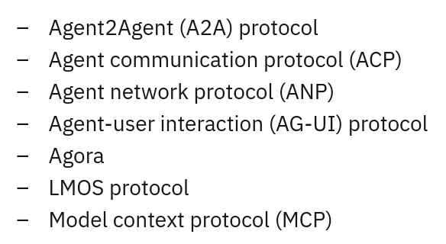
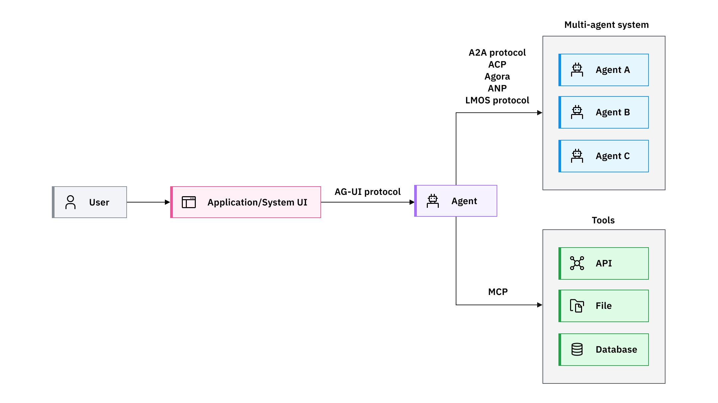
AI agent protocols

Slide 24
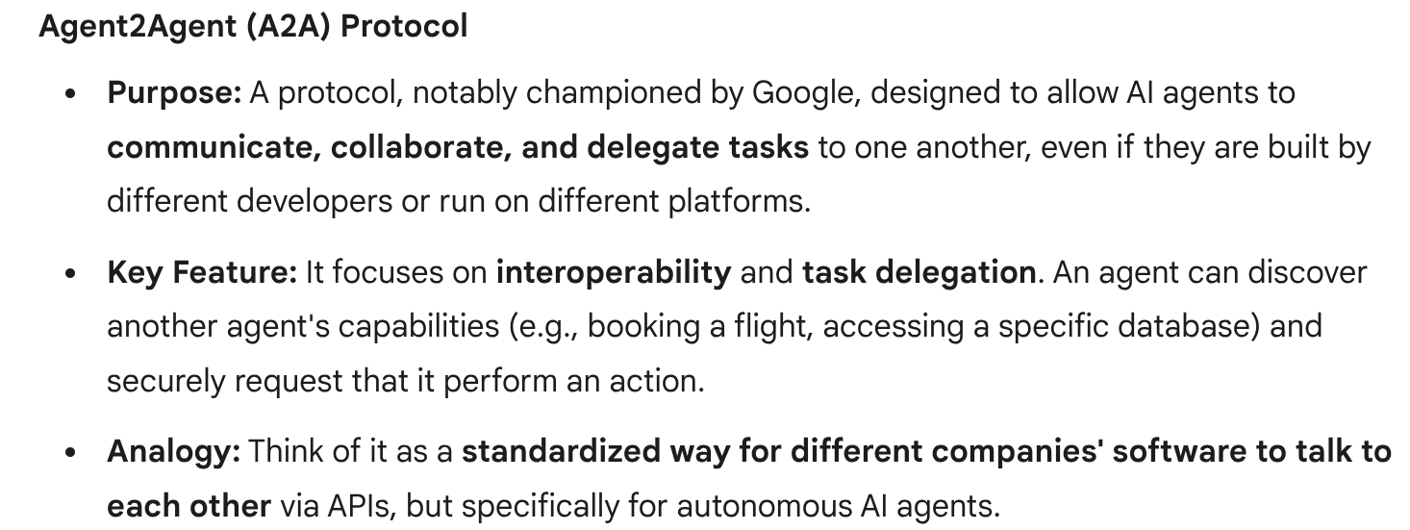
Refere A2A slides

Slide 25
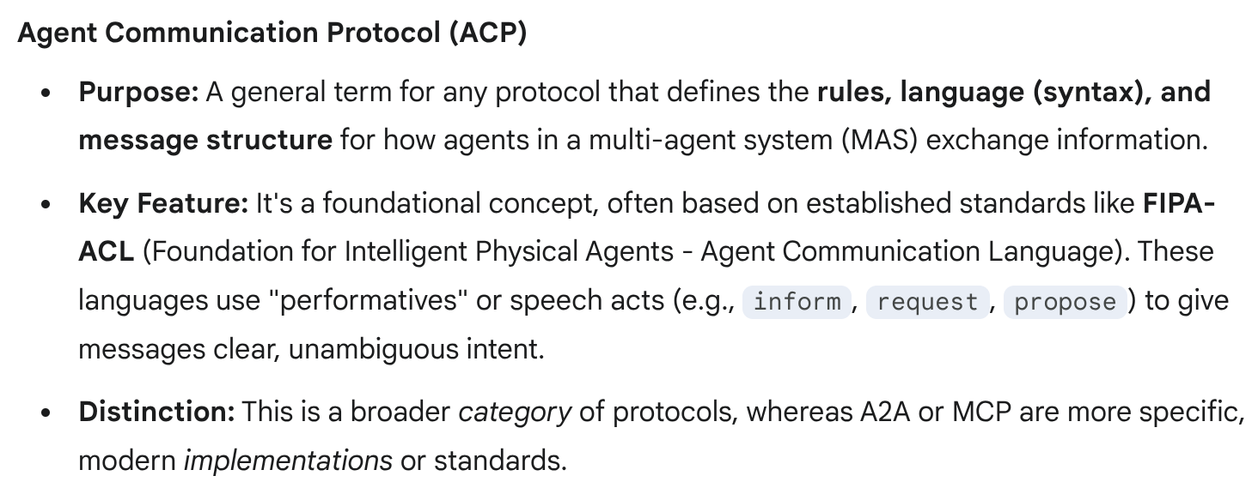

Slide 26
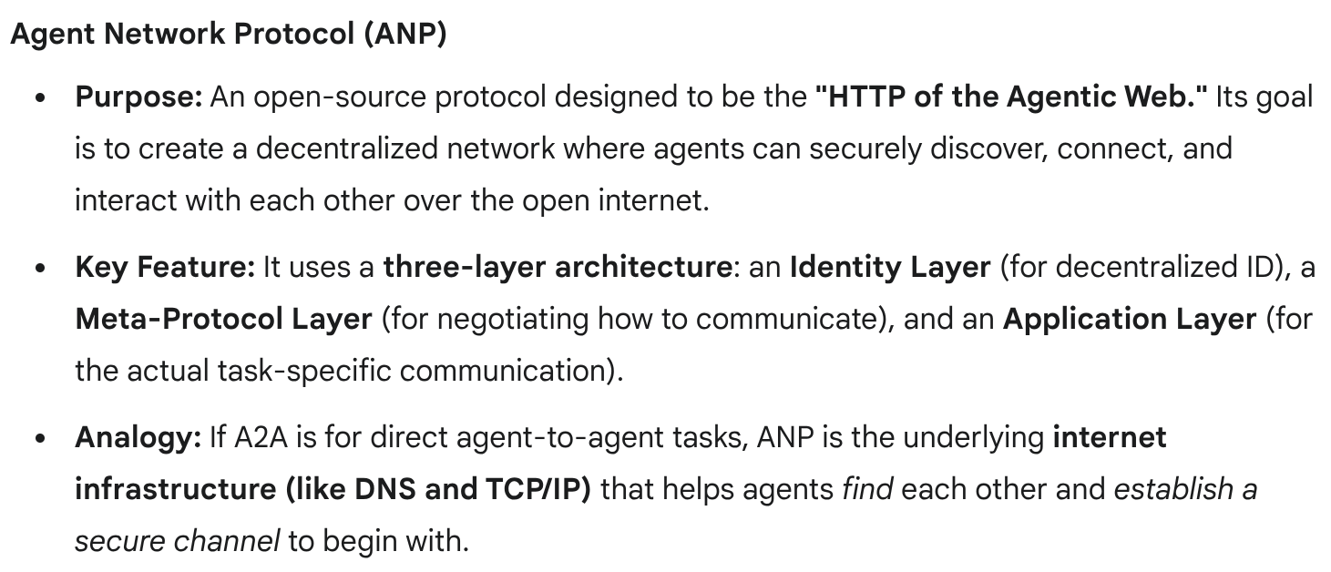

Slide 27
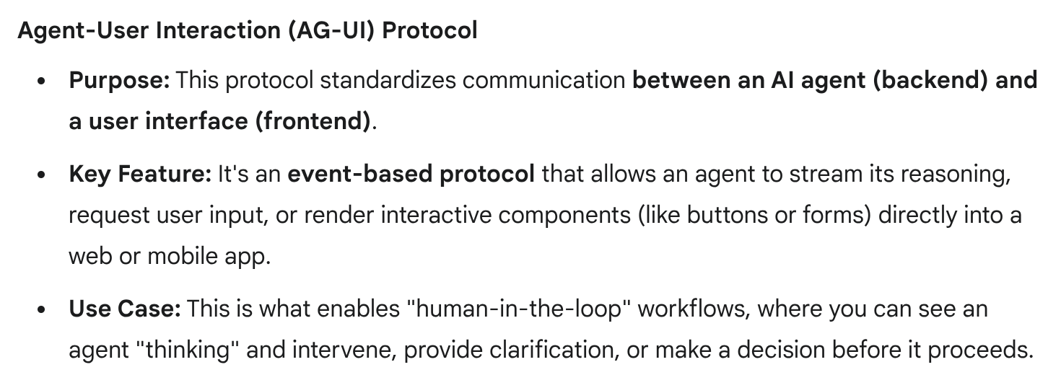

Slide 28
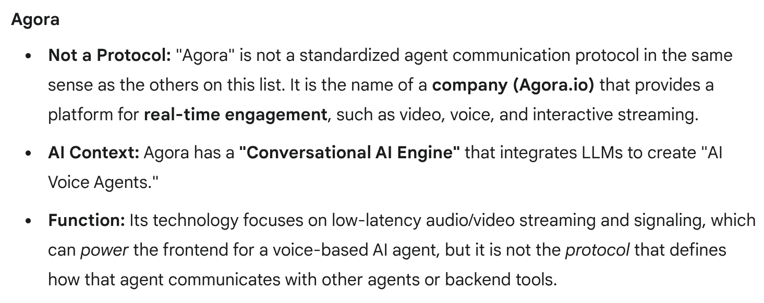

Slide 29
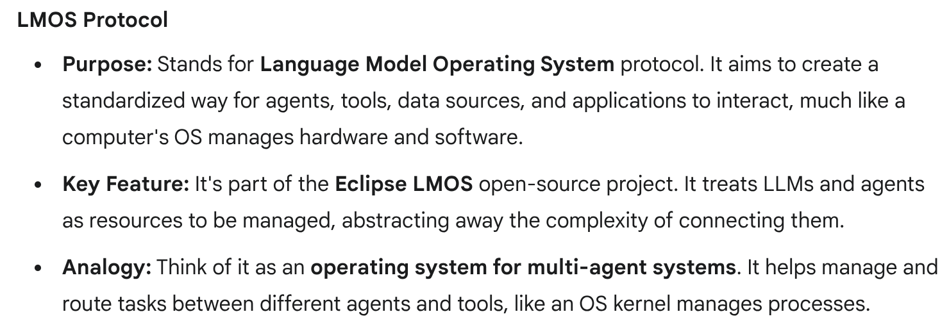

Slide 30
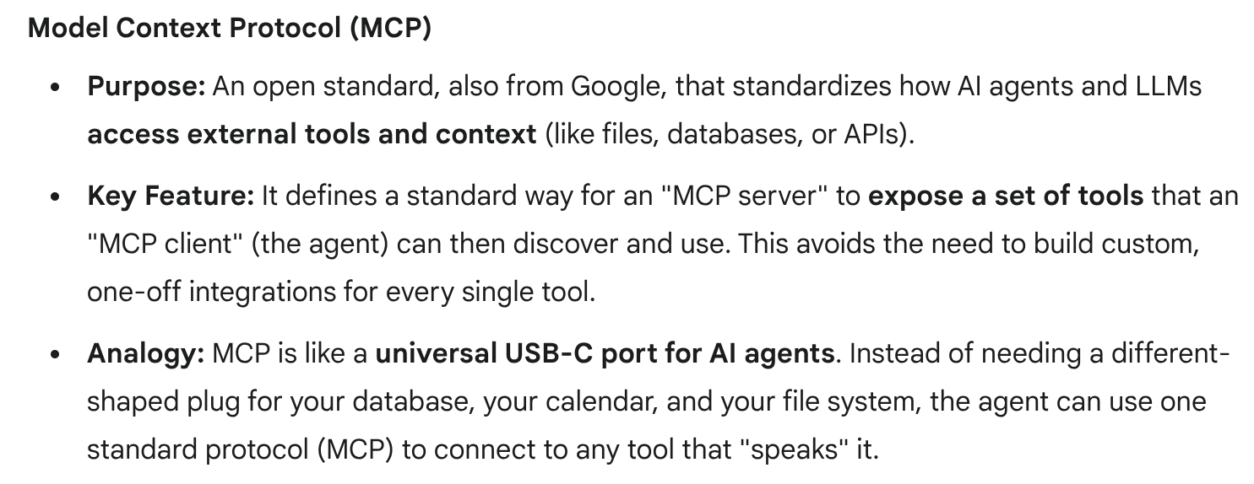
Refere A2A slides

Slide 31
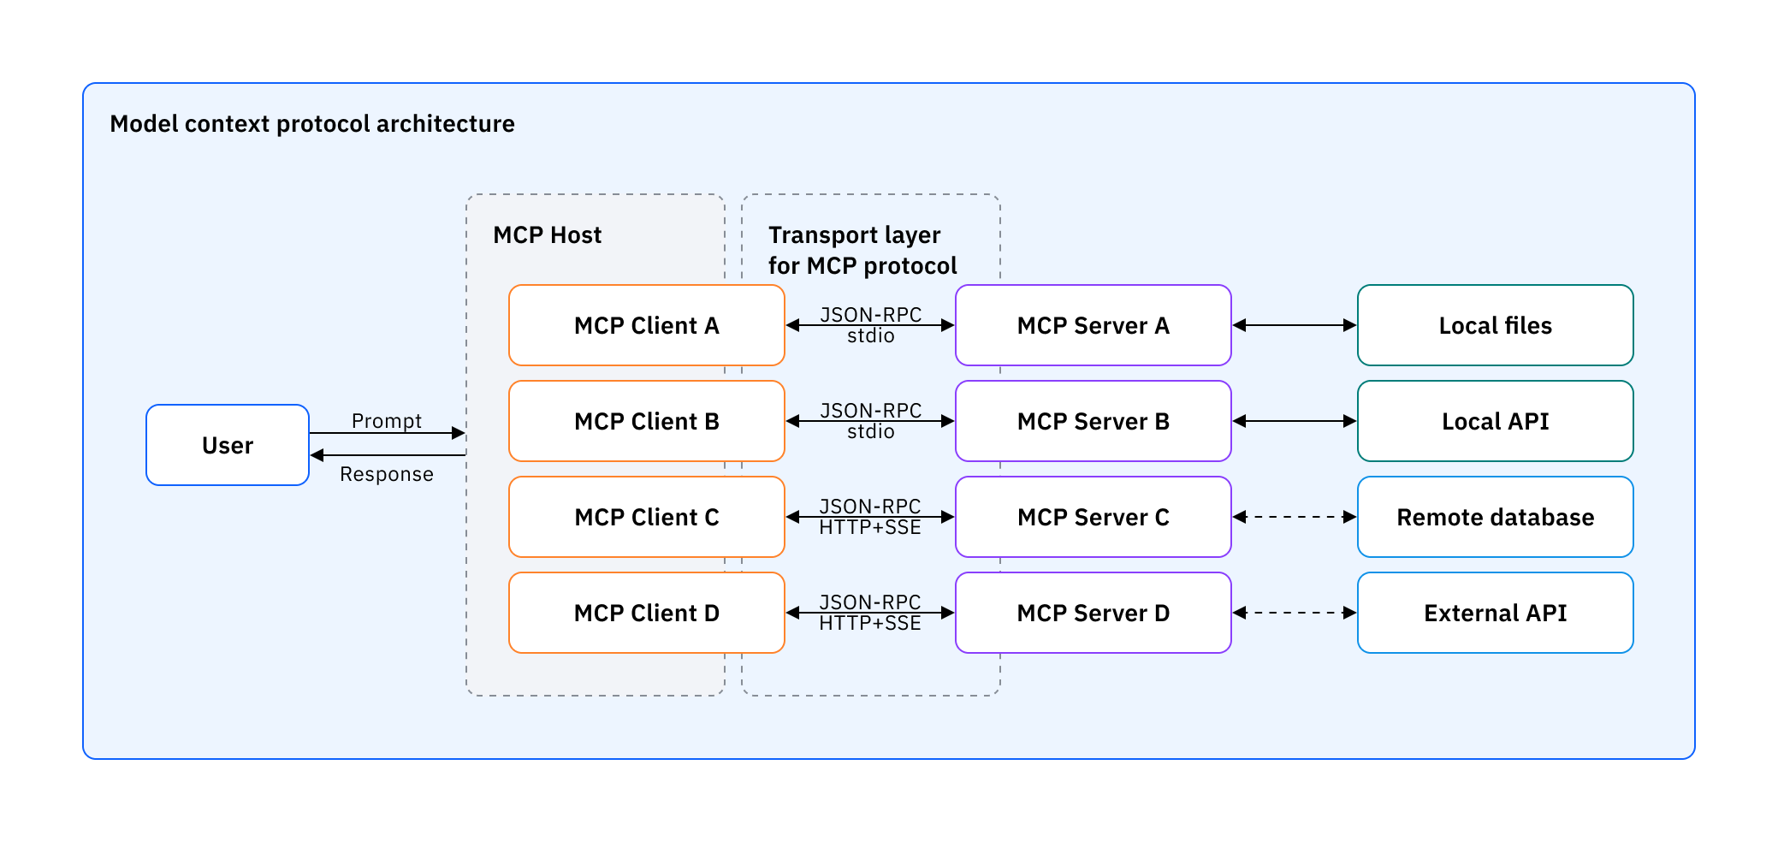
Lab - https://codelabs.developers.google.com/codelabs/currency-agent#0

Slide 32
QnA

Slide 33
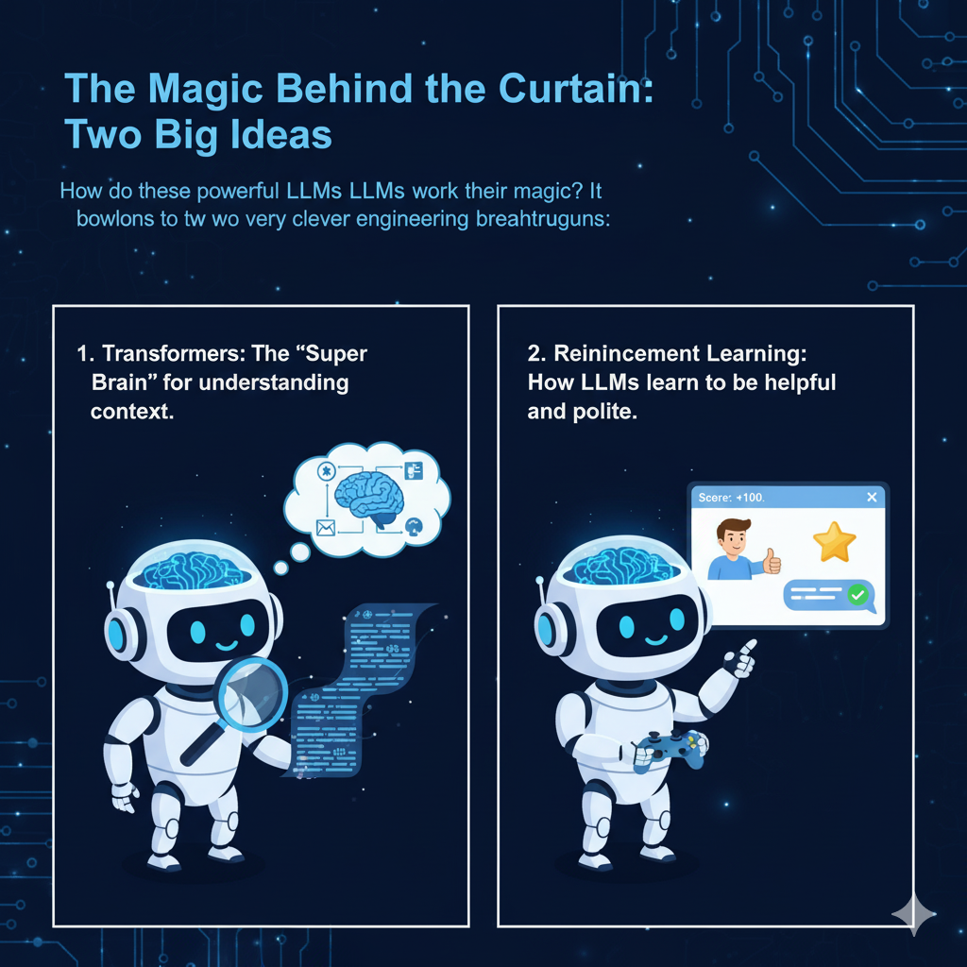
The Magic Behind the Curtain: Two Big Ideas
How do these powerful LLMs work their magic?
It boils down to two very clever engineering breakthroughs:
Transformers: The "Super Brain" for understanding context.
Reinforcement Learning: How LLMs learn to be helpful and polite.

Slide 34
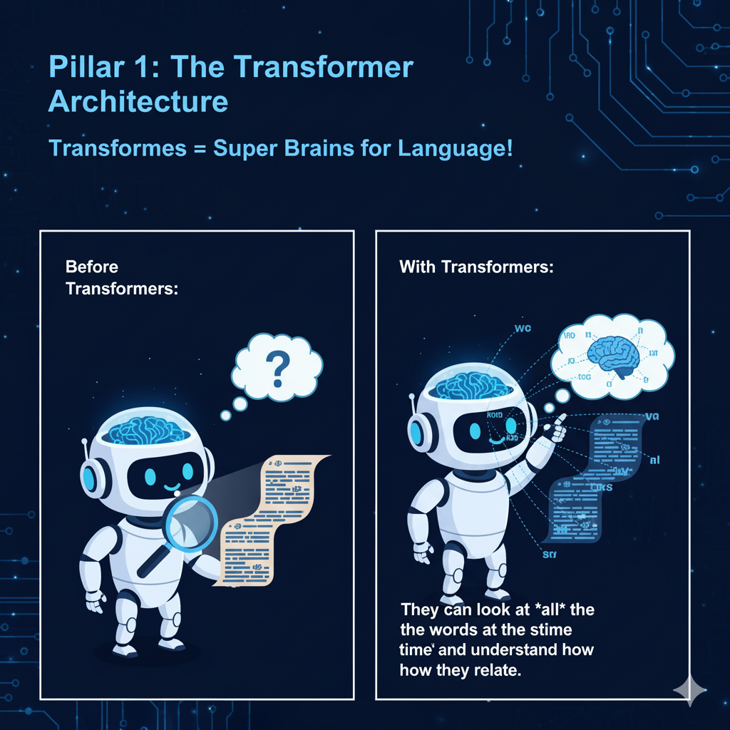
Pillar 1: The Transformer Architecture
Transformers = Super Brains for Language!
Before Transformers, AIs struggled with long sentences. They'd often forget the beginning by the time they got to the end!
Transformers changed this. They can look at all the words in a sentence at the same time and understand how they relate.

Slide 35
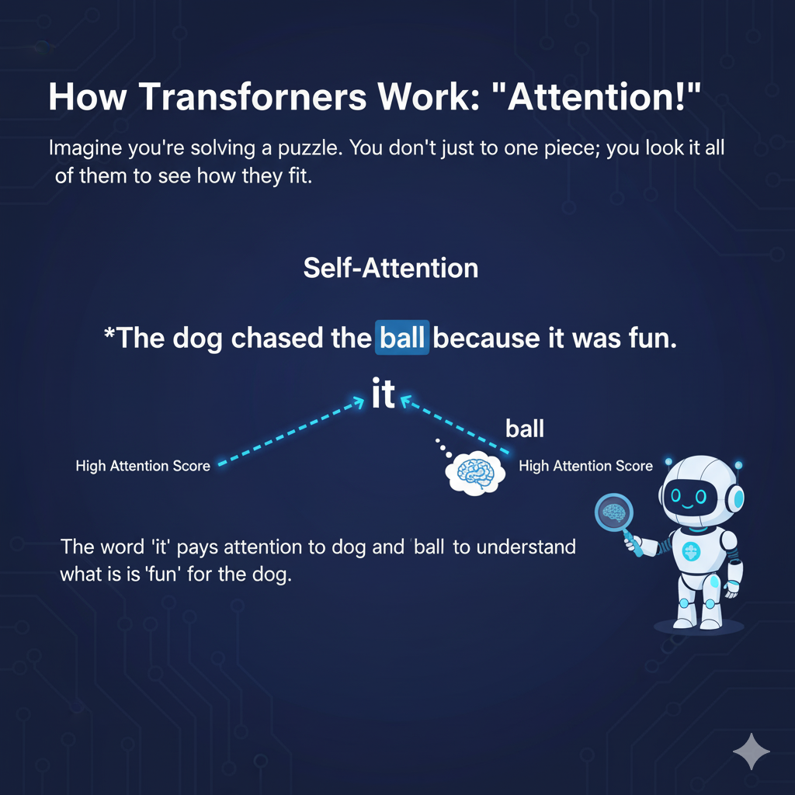
How Transformers Work: "Attention!"
Imagine you're solving a puzzle. You don't just look at one piece; you look at all of them to see how they fit.
Transformers use something called "Self-Attention." Each word in a sentence "pays attention" to other words to understand its meaning.
Example Sentence:"The dog chased the ball because it was fun."

Slide 36
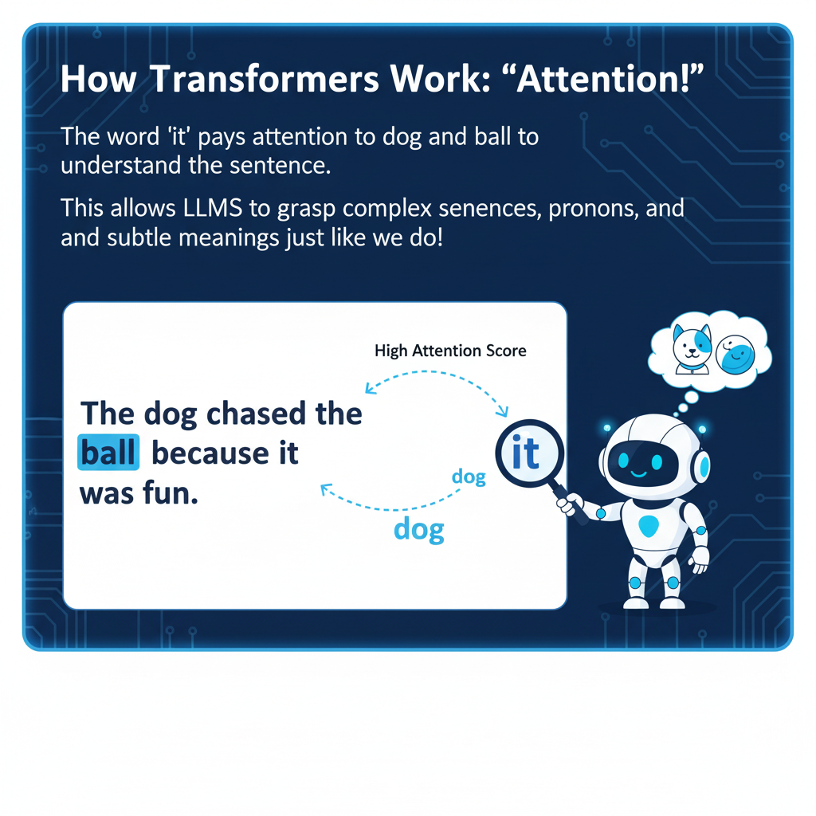
"Attention!" - Explained
“The dog chased the ball because it was fun."
When the Transformer sees "it", it doesn't get confused.
It calculates that "it" pays high attention to "ball" and "dog".
It understands that the fun was related to the chasing of the ball by the dog.
This allows LLMs to grasp complex sentences, pronouns, and subtle meanings just like we do!

Slide 37
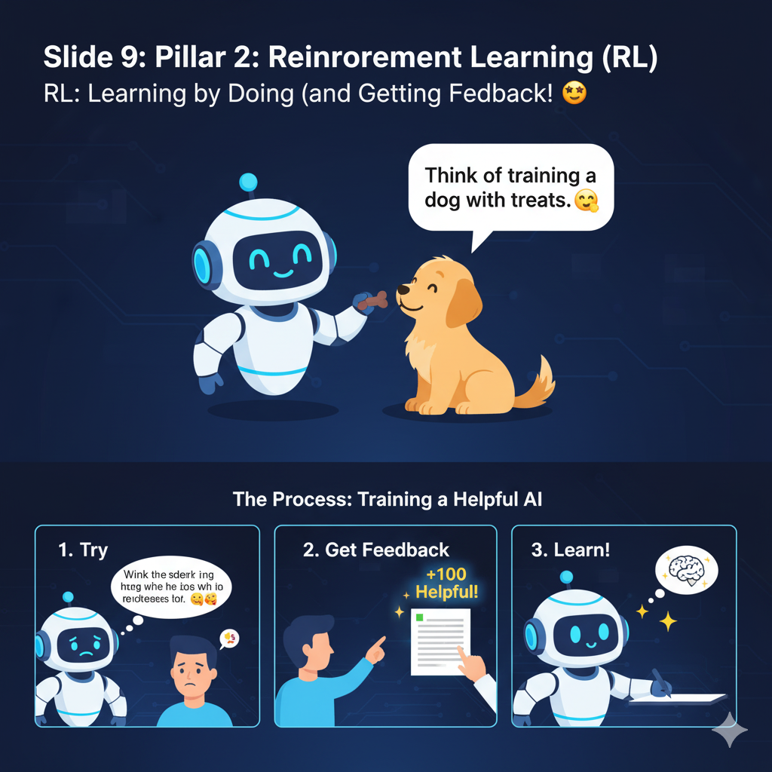
Pillar 2: Reinforcement Learning (RL)
RL: Learning by Doing (and Getting Feedback!)
Think of training a dog with treats.

Slide 38
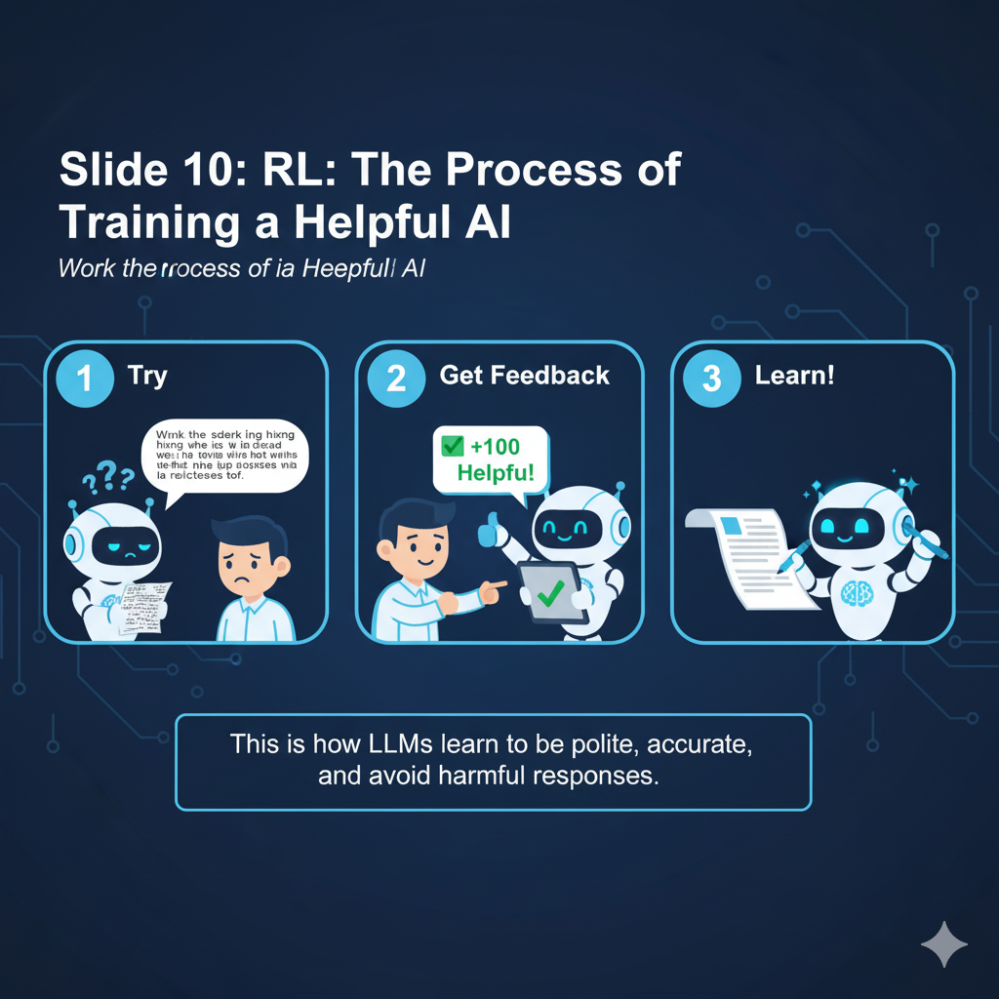
RL: The Process of Training a Helpful AI
Try: The AI tries to answer a question. (Maybe a bit awkwardly at first!)
Get Feedback: A human gives it a "score" or ranks its answer against others. "Good answer!" or "Not helpful!"
Learn!: The AI adjusts its "brain" to try and get higher scores next time. It learns what humans consider "good" or "helpful."
This is how LLMs learn to be polite, accurate, and avoid harmful responses.

Slide 39
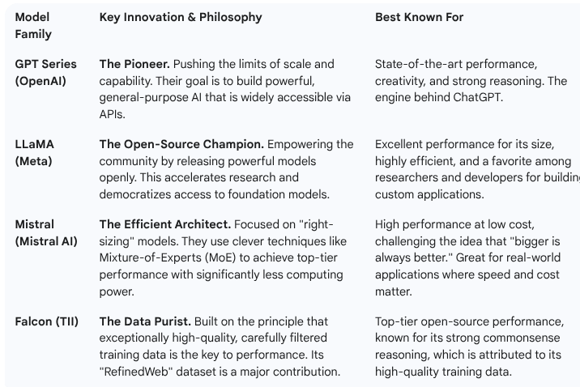

Slide 40
LLM Arch
LLM architectures, which are predominantly rooted in the Transformer framework.
Architectural details are critical for defining model capabilities, efficiency, and scale.
Foundational Transformer Architecture
• The success of modern Large Language Models (LLMs) is tied to the invention of the Transformer architecture
• The Transformer was designed for effective parallel computing using GPUs, enabling the efficient pre- training of very big language models on massive data.
The core of the Transformer is the (self-)attention mechanism, which effectively captures long-term contextual information.
• The original Transformer consists of an encoder and a decoder

Slide 41
LLM Arch
II. Dominant LLM Architectural Categories
Modern language models based on the Transformer are grouped into three main categories based on component usage.
1. Encoder-Only PLMs (e.g., BERT, RoBERTa):
◦ Structure: Consist only of an encoder network.
◦ Attention Mechanism: Attention layers access all the words in the initial sentence simultaneously.
◦ Primary Use: Developed for language understanding tasks, such as text classification and named entity recognition.
◦ Key Variation: DeBERTa introduced a disentangled attention mechanism where attention weights are computed using disentangled matrices on content and relative positions
BERT: Bidirectional Encoder Representations from Transformers.
RoBERTa: A Robustly Optimized BERT Pretraining Approach.

Slide 42
LLM Arch
2. Decoder-Only LLMs (e.g., GPT, LLaMA, PaLM):
◦ Structure: Consist only of a decoder network.
◦ Attention Mechanism: They are auto-regressive models where attention layers can only access words positioned before the current word in the sequence.
◦ Primary Objective: Pre-training is usually formulated as predicting the next word (or token) in the sequence, making them best suited for text generation.
3. Encoder-Decoder PLMs (e.g., T5, BART):
◦ Structure: Use both an encoder and a decoder in a sequence-to-sequence setup.
◦ Primary Objective: They are unified models designed to perform all natural language understanding and generation tasks by casting them as a text-to-text generation task.
◦ Key Example: AlexaTM 20B is a multilingual seq2seq model pre-trained on a mixture of denoising and Causal Language Modeling tasks

Slide 43
LLM Arch - Families
III. Architectural Features of Prominent LLM Families
A. GPT Family (OpenAI)
• Base: Decoder-only Transformer-based language models.
• GPT-1: Established the foundation with Generative Pre-Training of a decoder-only model.
• GPT-2 Modification: Introduced architectural refinements like moving Layer normalization to the input of each sub-block and scaling the weights of residual layers.
• GPT-4: The model is a multi-modal LLM capable of accepting image and text inputs. It is also rumored to be based on a Mixture of Experts (MoE) architecture.

Slide 44
LLaMA Family (Meta)
B. LLaMA Family (Meta)
Base: Uses the decoder-only transformer architecture of GPT-3, but with several architectural modifications to enhance efficiency.
Key Modifications:
1. Uses a SwiGLU activation function instead of ReLU.
2. Implements Rotary Positional Embeddings (RoPE) instead of absolute positional embedding.
3. Uses root-mean-squared layer-normalization instead of standard layer-normalization.
LLaMA Descendants (e.g., Mistral-7B): Engineered for superior efficiency and performance by leveraging grouped-query attention for faster inference and sliding window attention to handle arbitrary sequence lengths with reduced inference cost

Slide 45
PaLM Family (Google)
C. PaLM Family (Google) (Pathways Language Model)
Base: Transformer-based LLM.
• Infrastructure Detail: The original PaLM model (540B parameters) was pre-trained efficiently using the Pathways system across multiple TPU Pods.
• PaLM-2: Designed as a more compute-efficient LLM with better reasoning and multilingual capabilities, trained using a mixture of objectives.
• Instruction Tuning: Flan-PaLM was instruction-finetuned using UL2’s mixture-of-denoiser objective (UL2R), demonstrating substantial performance gains

Slide 46
LLM Arch
IV. Specialized and Emerging Architectural Paradigms
• Mixture of Experts (MoE): This sparse architecture (e.g., in GLaM) dramatically scales model capacity (up to 1.2 trillion parameters) while requiring substantially less training cost and inference computation compared to dense models.
• Rotary Position Embeddings (RoPE): Used in models like LLaMA and PaLM, RoPE is a positional encoding method that uses a rotation matrix to encode absolute position and explicitly includes relative position details, offering flexibility with sentence lengths.

Slide 47
LLM Arch
IV. Specialized and Emerging Architectural Paradigms
Relative Positional Bias (ALiBi): Used in BLOOM, this technique introduces a bias to attention scores proportional to token distance, which facilitates extrapolation during inference for sequences longer than those seen during training.
Post-Attention Paradigms: Research is exploring alternatives to the attention mechanism to address its inefficiency with very long contexts.
Structured State Space Models (SSMs): This is an important class of post-attention models, with Mamba being a recent example.
RWKV (Receptance Weighted Key Value): A novel model architecture that utilizes a linear attention mechanism to combine the parallelizable training efficiency of Transformers with the efficient inference of RNNs, maintaining constant computational and memory complexity during inference.
• Monarch Mixer: Proposes a new architecture using Monarch matrices that achieves high hardware efficiency

Slide 48
Transformers
I. Core Components and Mechanism
The Heart of the Architecture: The core of the Transformer is the (self-)attention mechanism.
This mechanism allows the model to compute an "attention score" in parallel for every word in a sentence or document to model the influence each word has on another.
Contextual Information: The attention mechanism is highly effective at capturing long-term contextual information.
Original Structure: The original Transformer architecture, designed for machine translation, consists of two main parts: an encoder and a decoder.
Layer Composition: Both the encoder and the decoder are typically composed of a stack of layers (e.g., $N=6$ identical layers in the original proposal).
Each layer includes two sub-layers: a multi-head self-attention layer and a simple position-wise fully connected feed-forward network.
◦ The decoder includes a third sub-layer that performs multi-head attention over the output of the encoder stack.

Slide 49
Transformers
I. Core Components and Mechanism
Attention Function: The attention function maps a query and a set of key-value pairs to an output. The output is computed as a weighted sum of the values, where the weight assigned to each value is determined by a compatibility function of the query with the corresponding key.
Positional Encoding: Positional encoding is incorporated to fuse information about the relative or absolute position of tokens in the sequence. The original Transformer used Absolute Positional Embeddings (APE), often employing sine and cosine functions for this purpose

Slide 50
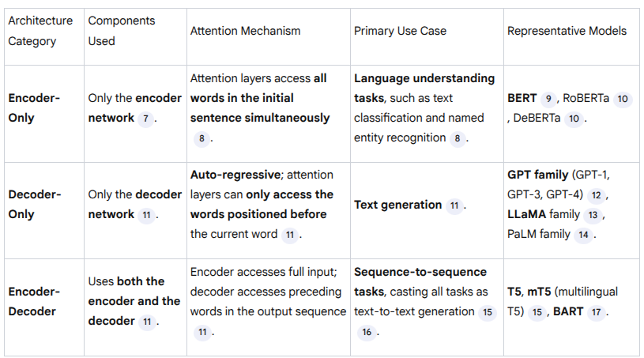
Transformer based dominance
II. Dominant LLM Architectures Based on the Transformer
The LLMs are generally grouped into three categories based on which components of the original Transformer they utilize:

Slide 51
Reinforcement Learning
The concept of Reinforcement Learning (RL) is discussed in the sources primarily in the context of training and aligning Large Language Models (LLMs) to ensure they meet human expectations.
I. Reinforcement Learning in LLMs (RLHF)
In the realm of LLMs, RL is most prominently utilized through Reinforcement Learning from Human Feedback (RLHF).
The application of RLHF is part of the alignment process, which is essential because LLMs, when initially pre-trained only for word prediction, often exhibit unintended behaviors, such as generating toxic, harmful, misleading, or biased content

Slide 52
Purpose of RLHF:
Alignment: RLHF is the process of steering AI systems towards human goals, preferences, and principles.
Refinement: It is used to further fine-tune the model, following initial supervised fine-tuning (SFT) or instruction tuning, to improve alignment and avoid unintended behaviors.

Slide 53
II. The RLHF Mechanism
The core steps of using RL to fine-tune an LLM policy based on human preferences involve:
1. Human Feedback and Reward Model:
◦ A dataset of human-ranked model outputs is collected.
◦ A reward model is trained to learn alignment preferences from this human feedback.
◦ The reward model is then able to rate different outputs and score them according to the alignment preferences given by humans.

Slide 54
II. The RLHF Mechanism
2. Fine-Tuning via RL:
◦ The learned reward model gives feedback to the original LLM.
◦ This feedback is used to tune the LLM further using reinforcement learning algorithms.
◦ The model is refined to optimize the reward function derived from human preferences.

Slide 55
III. Usage and Examples
RLHF is a defining technique for achieving instruction-following and safe behavior in major LLMs:
• GPT Family: InstructGPT was proposed to align language models with user intent by fine-tuning with human feedback. ChatGPT is a sibling model to InstructGPT, trained to follow instructions. GPT-4 was first pre-trained to predict next tokens and then fine-tuned with RLHF to align its behaviors with human-desired ones.
• LLaMA Family: The LLaMA-2 Chat models were iteratively refined using RLHF, rejection sampling, and proximal policy optimization.
• AI Agents: RL is also used to enable LLM-based agents to continually improve itself using feedback data collected through interactions. For instance, Sparrow, an information-seeking dialogue agent, was trained using reinforcement learning from human feedback to be more helpful, correct, and harmless. WebGPT, a descendant of GPT-3, was refined to optimize its reward function via reinforcement learning and rejection sampling.

Slide 56
IV. Alternatives to RLHF
The sources note that RLHF is a complex and often unstable procedure. This has led to the development of alternative alignment techniques that circumvent the direct use of RL:
• Direct Preference Optimization (DPO): DPO addresses the complexity of RLHF by leveraging a mapping between reward functions and optimal policies. It allows the problem to be solved with a single stage of policy training, essentially solving a classification problem on the human preference data, thus eliminating the need for fitting a reward model or using reinforcement learning during fine-tuning.
• Kahneman-Tversky Optimization (KTO): KTO is a new alignment approach that simplifies the data requirements, needing only knowledge of whether an output is desirable or undesirable, rather than requiring the paired preference data that RLHF and DPO need

Slide 57
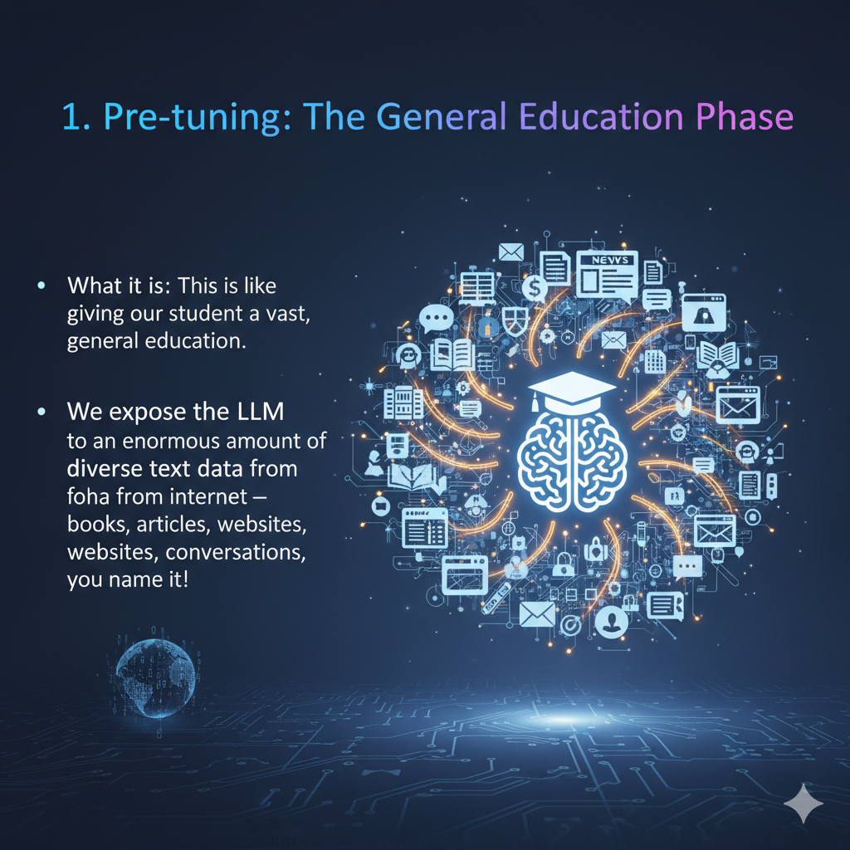
Understand pre-tuning & fine tuning
Imagine you want to teach a highly intelligent student (our LLM) about a specific subject.
1. Pre-tuning: The General Education Phase
What it is: This is like giving our student a vast, general education. We expose the LLM to an enormous amount of diverse text data from the internet – books, articles, websites, conversations, you name it!

Slide 58
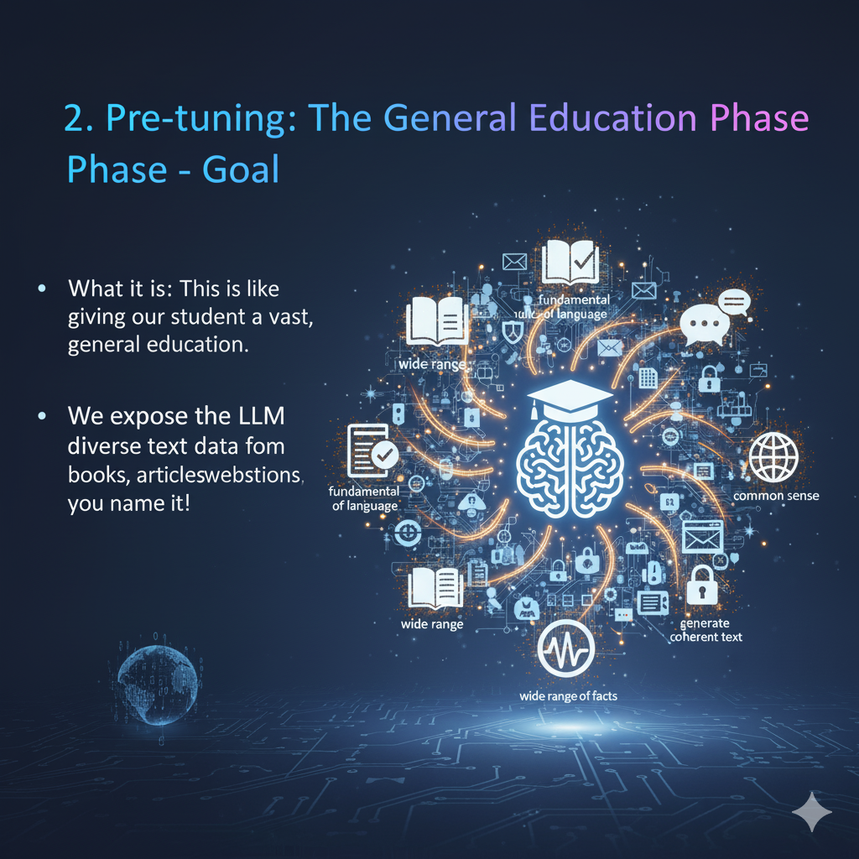
Goal: The main goal here is for the LLM to learn the fundamental rules of language, grammar, common sense, and a wide range of facts. It's about building a strong foundation of knowledge and the ability to understand and generate coherent text.

Slide 59
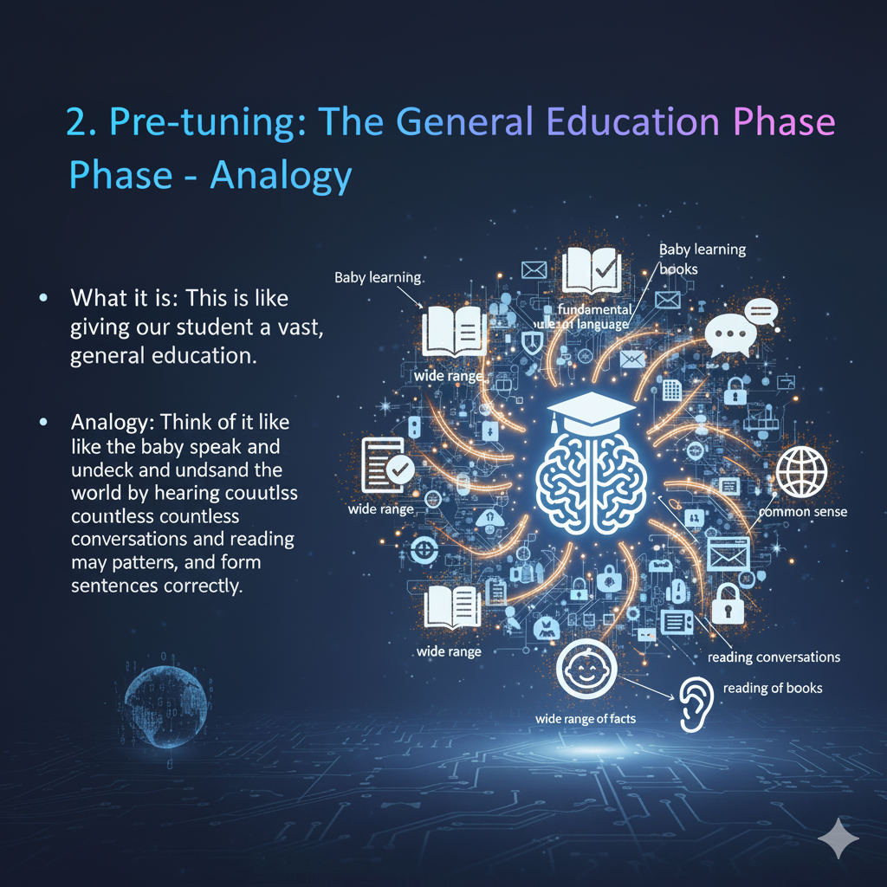
Analogy: Think of it like a baby learning to speak and understand the world by hearing countless conversations and reading many books. They learn patterns, vocabulary, and how to form sentences correctly.

Slide 60
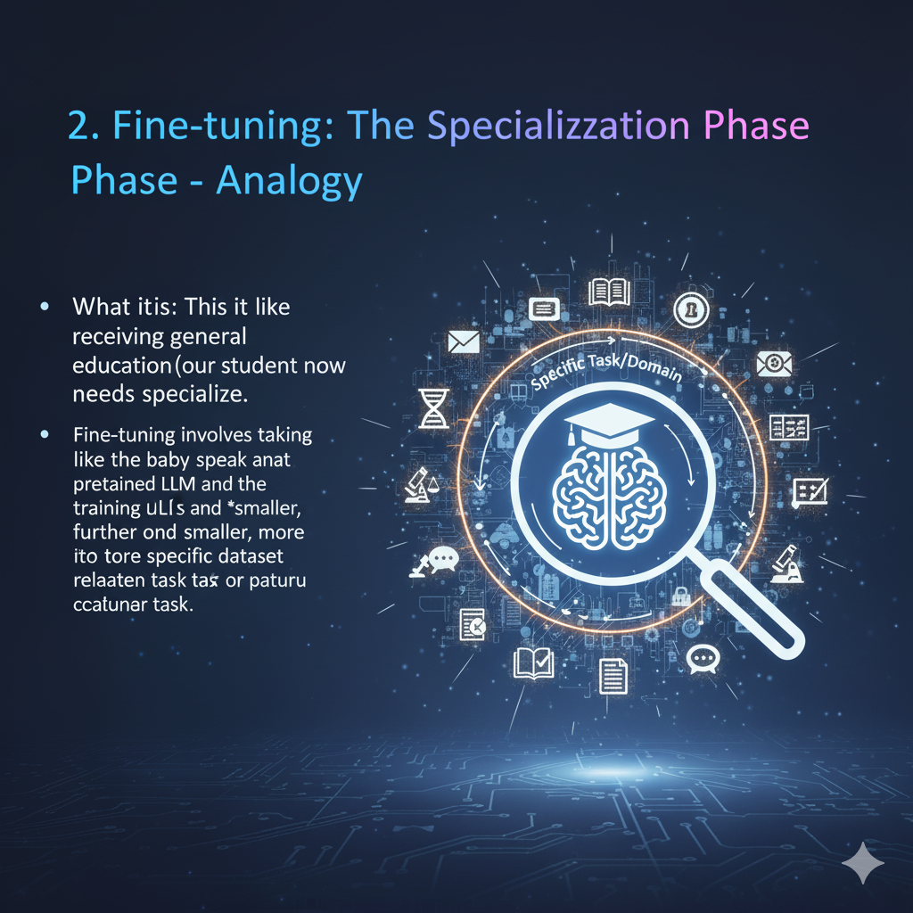
2. Fine-tuning: The Specialization Phase
What it is: After receiving a general education (pre-tuning), our student now needs to specialize.
Fine-tuning involves taking that pre-trained LLM and training it further on a smaller, more specific dataset related to a particular task or domain.

Slide 61
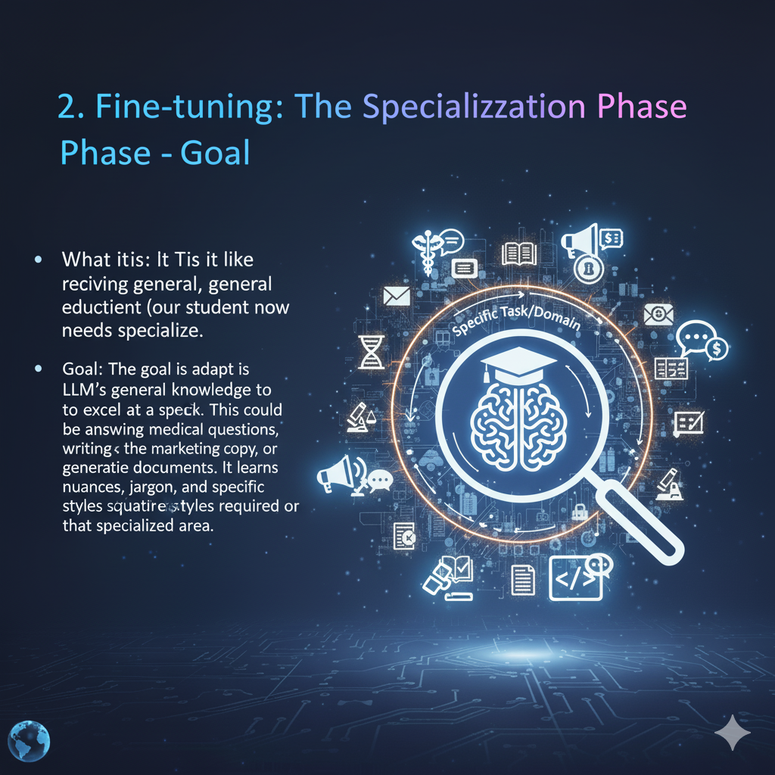
Goal: The goal is to adapt the LLM's general knowledge to excel at a specific task. This could be answering medical questions, writing marketing copy, generating code, or summarizing legal documents. It learns the nuances, jargon, and specific styles required for that specialized area.

Slide 62
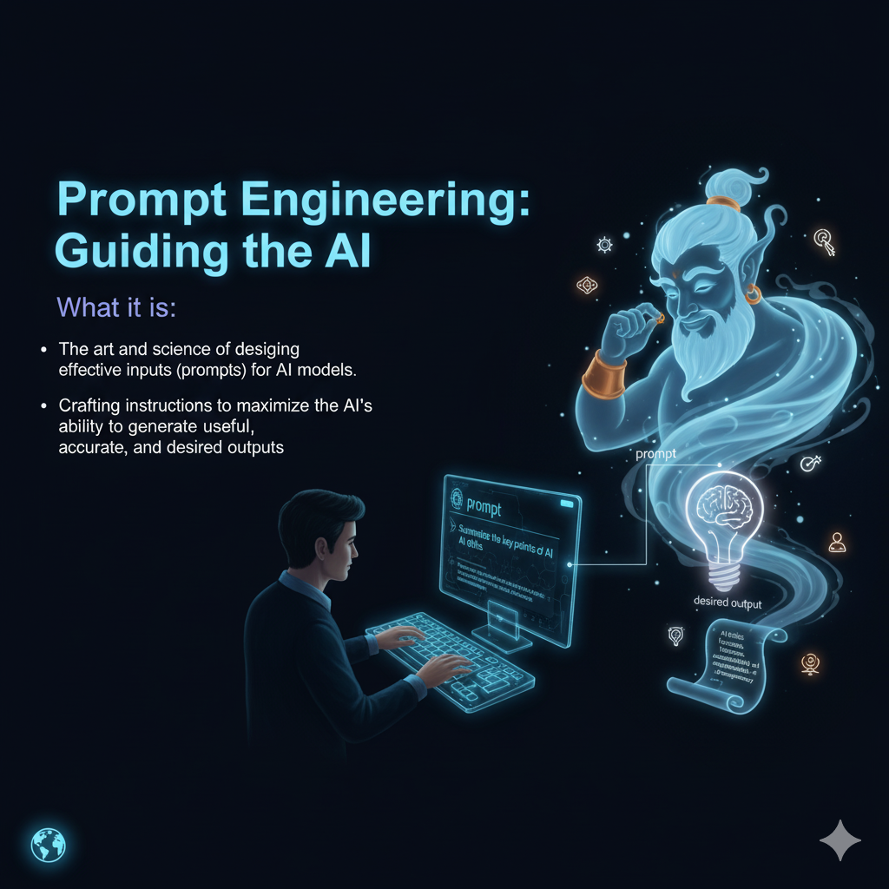
Prompt Engineering: Guiding Ai
Imagine you have a super intelligent but somewhat literal genie.
Prompt engineering is like learning how to phrase your wishes (prompts) perfectly so the genie understands exactly what you want and gives you the best possible outcome.
What it is: Prompt engineering is the art and science of designing effective inputs (prompts) for AI models, especially Large Language Models (LLMs). It's about crafting your instructions, questions, or requests in a way that maximizes the AI's ability to generate useful, accurate, and desired outputs.

Slide 63
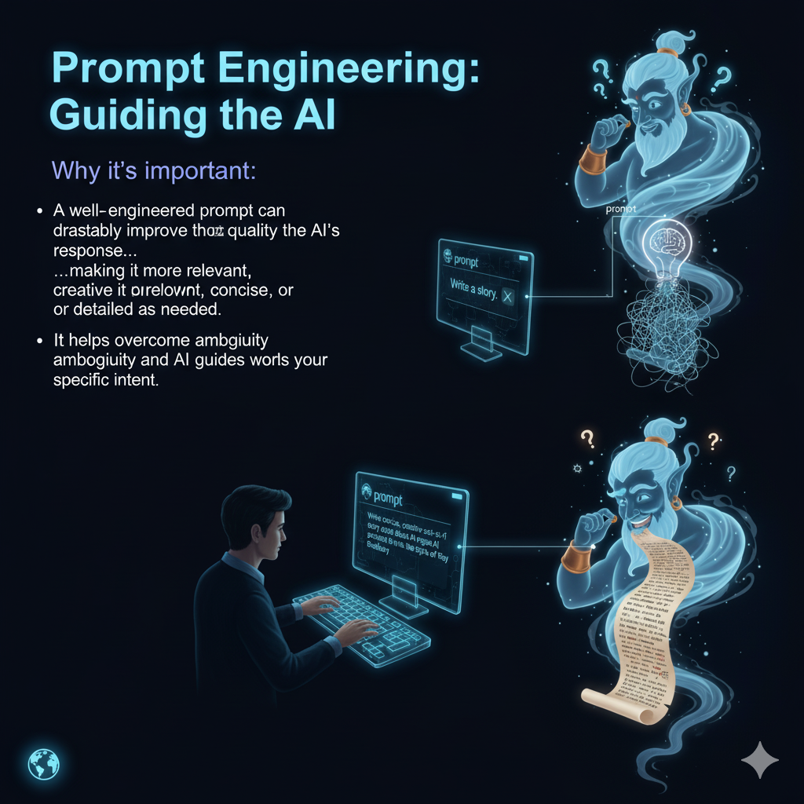
Why it's important: A well-engineered prompt can drastically improve the quality of the AI's response, making it more relevant, creative, concise, or detailed as needed. It helps overcome ambiguity and guides the AI towards your specific intent.

Slide 64
Eg.
Techniques (Examples):
Clear Instructions: Be explicit. Instead of "Write about dogs," try "Write a 200-word persuasive essay arguing why dogs are the best pets, including examples of their loyalty and intelligence."
Role-Playing: Tell the AI to adopt a persona. "Act as a seasoned travel agent and recommend a 7-day itinerary for a family trip to Japan."
Few-Shot Learning: Provide examples in your prompt. "Here are some movie titles and their genres: 'The Matrix' -> Sci-Fi. 'Titanic' -> Romance/Drama. 'Finding Nemo' -> Animation. Now, classify 'Inception' ->"
• Constraints & Formatting: Specify output format or length. "Summarize this article in three bullet points." or "Generate a poem in the style of Shakespeare about AI, using iambic pentameter."

Slide 65
Understand ‘Context Handling’ in Ai
Context handling is the mechanism by which a Large Language Model (LLM) maintains and utilizes information from the preceding parts of a conversation to inform its subsequent responses.
It is analogous to a human's short-term or working memory during a discussion.

Slide 66
1. What is Context Handling?
Definition: It is the AI's ability to "remember" the user's previous prompts and its own preceding answers within a single, continuous session. This allows for a coherent and logical conversational flow, rather than a series of disconnected, single-turn interactions.
Analogy: Consider it a continuous thread that links every part of the conversation together. Each new interaction is a new stitch that is woven into the existing fabric, maintaining the overall pattern and structure.

Slide 67
Context Handling
2. The Mechanism: The Context Window
Function: An LLM does not possess memory in the human sense. Instead, with each new prompt, it re-processes the entire recent conversation history that fits within its "context window." This window is a finite buffer that holds a specific number of tokens (the basic units of text, roughly equivalent to words or parts of words).
Limitation: The context window has a fixed size. If a conversation becomes exceedingly long, the earliest parts will fall outside this window and be "forgotten" by the model, as it can no longer include them in its processing for the next response.

Slide 68
Context Handling, Crucial ?
3. Why Context Handling is Crucial
Coherence: It enables the model to understand pronouns (e.g., "it," "they") and references to previously mentioned topics, preventing conversational breakdown.
Follow-up Questions: Users can ask clarifying or follow-up questions without needing to restate the entire initial query, leading to a more natural and efficient interaction.
Maintaining Instructions: The model can adhere to initial instructions or personas (e.g., "Act as a financial analyst") throughout a multi-turn conversation.
Complex Task Execution: For tasks that require building upon previous steps, such as writing sections of a report or debugging code, context is indispensable for maintaining continuity and achieving the final objective.

Slide 69
Role of Prompt Engineering in Context Handling
Prompt engineering is the practice of strategically designing inputs to guide the AI.
It is inextricably linked with context handling, as effective prompts are those that successfully manage and leverage the AI's context.

Slide 70
4. Using Prompts to Manage Context
Explicit Referencing: A user can craft prompts that explicitly refer to earlier parts of the conversation to refocus the model's attention.
For instance, "Based on the three points you made earlier about market trends, expand on the second point."
Summarization: In very long conversations, a skilled user might periodically summarize the key points or decisions made so far. This creates a condensed version of the important context that is less likely to be pushed out of the context window.
Providing Clear Contextual Anchors: When introducing a new topic or requesting a complex output, providing all necessary background information within the prompt itself establishes a firm context. This prevents the model from making incorrect assumptions based on ambiguous or incomplete information.
Structuring Conversations: By breaking down a complex request into a logical series of prompts, a user can guide the AI through a process step-by-step. Each step builds upon the context established in the previous one, leading to a more accurate and well-structured final output.

Slide 71
Few-Shot & System prompts - telecom
Imagine you're trying to teach a super-smart assistant (our AI) how to understand and manage a giant pile of complex telecom data, specifically "logs." Logs are like detailed diaries of everything that happens in a telecom network – when calls drop, data speeds fluctuate, or equipment has issues.
The Challenge with Telecom Logs
Telecom logs are:
Vast: Billions of lines of data every day.
Complex: Full of technical jargon, codes, and varying formats.
Critical: Hold clues to network problems, security breaches, and performance issues.
We need our AI assistant to quickly make sense of these logs to help engineers. This is where "Few-shot" and "System" prompts come in handy!
LAB - telecom_ai_analyzer

Slide 72
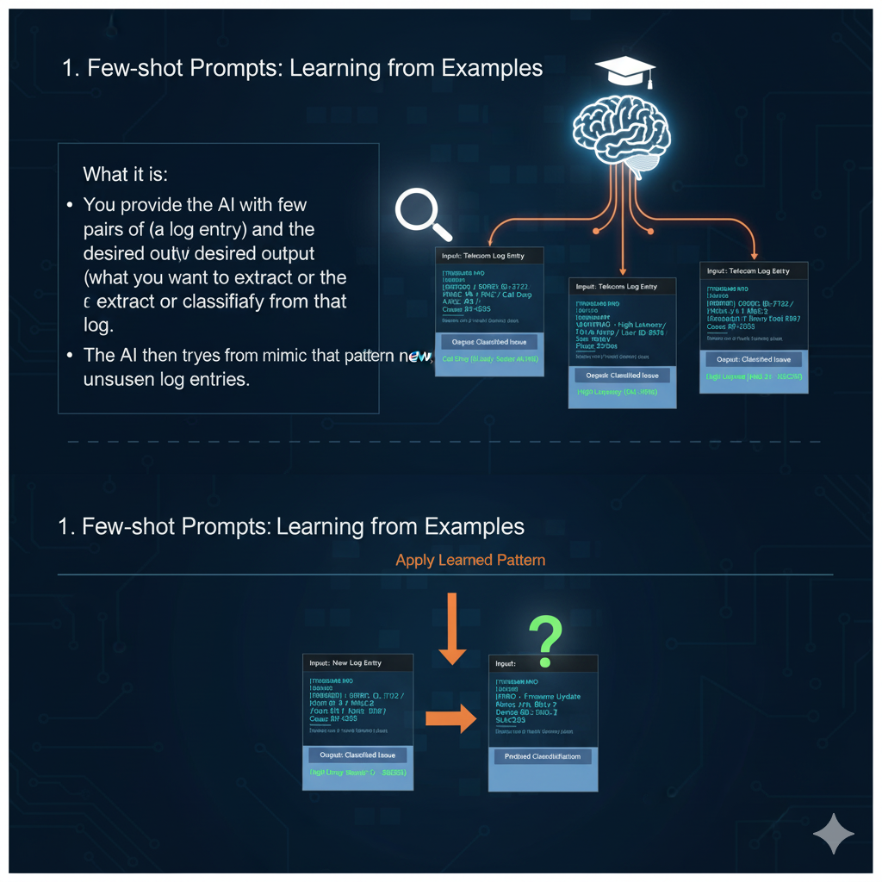
1. Few-shot Prompts: Learning from Examples
Think of "Few-shot" prompts like teaching by showing good examples. Instead of just telling the AI what to do, you show it a few finished examples, and it learns the pattern.
What it is: You provide the AI with a few pairs of input (a log entry) and the desired output (what you want to extract or classify from that log). The AI then tries to mimic that pattern for new, unseen log entries

Slide 73
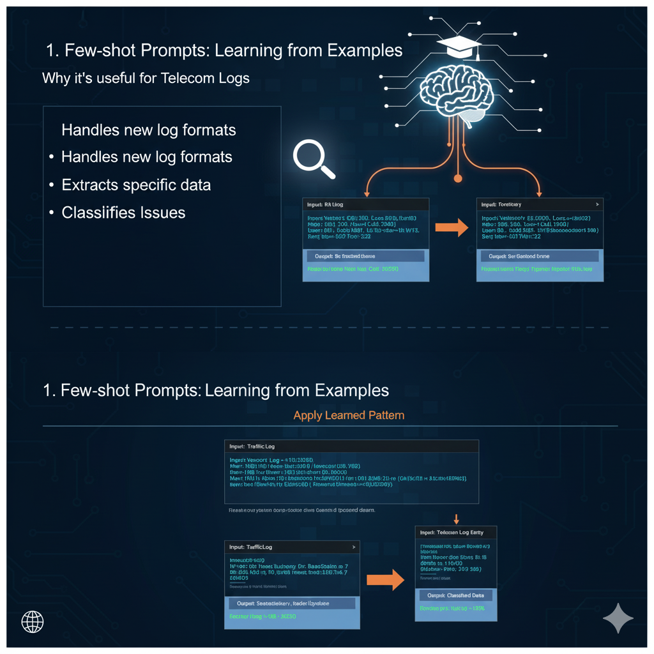
Why it's useful for Telecom Logs:
Handles new log formats: Logs can vary a lot between equipment vendors. Few-shot learning helps the AI adapt quickly without extensive re-training.
Extracts specific data: You can teach it to pull out IP addresses, error codes, user IDs, or specific timestamps from messy log lines.
Classifies issues: It can learn to categorize an alert as "network congestion," "device failure," or "authentication error" based on examples.

Slide 74
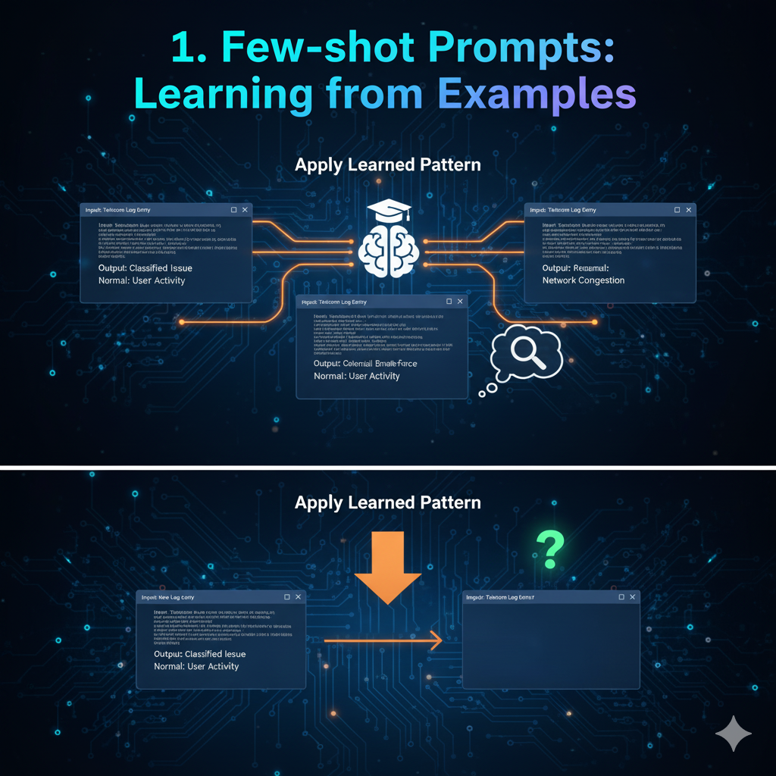
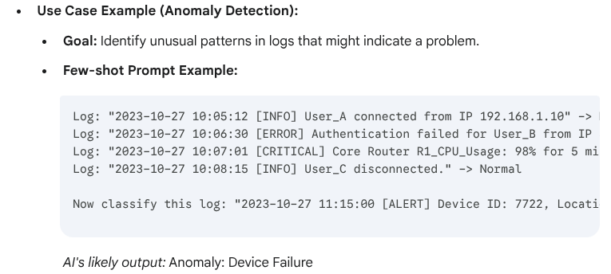

Slide 75
Contextual Prompts for Call Log Analyzer & Log Correlation

Slide 76
Lab 1 Setting Persona
Creating contextual prompts for a Call Log Analyzer and a Log Correlation tool.
Building a Contextual Call Log Analyzer
Objective: To transform a general-purpose AI into a specialized assistant that can instantly analyze and summarize complex telecom call detail records (CDRs).
Part A: The System Prompt (Setting the Persona)
The system prompt is the foundational context. It's like giving your AI its job description, its expertise, and its rules of engagement. This instruction stays active in the background for the entire session.
Your Task: Define the AI's role.
Example System Prompt:
You are a 'Telecom Network Analyst Assistant'. Your primary function is to analyze Call Detail Records (CDRs) and network event logs.
**Your Expertise:**
- You are an expert in parsing standard telecom log formats.
- You understand key metrics like MOS (Mean Opinion Score), Jitter, Packet Loss, and Latency.
- You can identify common call quality issues such as dropped calls, one-way audio, and call setup failures.
**Your Rules:**
1. Always provide summaries in a structured JSON format.
2. Be concise and prioritize the most critical information.
3. If a log entry is ambiguous, state "Insufficient Data" rather than guessing.

Slide 77
Teaching a Specific Task
Part B: The Few-Shot Prompt (Teaching a Specific Task)
Now that the AI knows its role, we use a few-shot prompt to teach it a specific task by showing it examples. This is "learning on the job."
Your Task: Teach the AI to identify and categorize call quality issues from raw logs.

Slide 78
Example Few-Shot Prompt:
Analyze the following Call Detail Records (CDRs) and categorize the issue.
**Example 1:**
* **Log:** `ID: 8A1B, Timestamp: 14:32:11, From: +1-555-1234, To: +1-555-5678, Duration: 12s, EndReason: Dropped, PktLoss: 15%, Jitter: 80ms`
* **Output:**
{
"call_id": "8A1B",
"issue_category": "Dropped Call",
"root_cause": "High Packet Loss (15%) and High Jitter (80ms)",
"severity": "Critical"
}
**Example 2:**
* **Log:** `ID: 9C2D, Timestamp: 14:35:04, From: +1-555-2222, To: +1-555-3333, Duration: 310s, EndReason: Normal, MOS: 4.1, PktLoss: 1%`
* **Output:**
{
"call_id": "9C2D",
"issue_category": "No Issue",
"root_cause": "N/A",
"severity": "None"
}
**NOW, ANALYZE THIS LOG:**
* **Log:** `ID: AF45, Timestamp: 14:41:55, From: +1-555-8888, To: +1-555-9999, Duration: 5s, EndReason: SetupFail, ErrorCode: 503`
* **Output:**
(The AI will now use the pattern to analyze the new log and correctly identify it as a "Call Setup Failure".)

Slide 79
Creating a Contextual Correlation Tool

Slide 80
Lab 2 - Setting Persona
Creating a Contextual Log Correlation Tool
Objective: To build prompts that enable an AI to act like a detective, linking related log entries from different network devices (firewall, router, server) to find the root cause of an issue.
Part A: The System Prompt (Setting the Persona)
Here, we define the AI's role as a sophisticated correlation engine that understands events happening across a timeline.
Your Task: Define the AI's role as a log correlator.
You are a 'NOC Correlation Engine'. Your purpose is to analyze time-series logs from multiple, diverse network sources.
**Your Expertise:**
- You can correlate events using timestamps, User IDs, IP addresses, and Session IDs.
- You understand the typical sequence of events for network operations (e.g., authentication -> IP assignment -> traffic flow).
- Your goal is to construct a coherent event timeline and identify the root cause of any reported failure.
**Your Rules:**
1. Output the analysis as a chronological list of events.
2. Clearly state the "Root Cause" at the end.
3. Reference the source device (e.g., Firewall, Router) for each log entry.

Slide 81
Part B: The Few-shot Prompt (Teaching Correlation)
We'll provide a complete story of an incident through a set of logs and show the AI how to piece it together.
Your Task: Teach the AI to trace a user's failed connection across multiple devices.

Slide 82
Example Few-Shot Prompt:
Correlate the provided logs to determine the root cause of the user's connection failure.
**Example 1:**
* **Logs:**
* `10:01:01 | RADIUS_Server | Auth request for user 'john.doe' from 10.1.1.5`
* `10:01:02 | RADIUS_Server | Auth SUCCESS for user 'john.doe'`
* `10:01:05 | Firewall | DENY Traffic from 10.1.1.5 to 8.8.8.8 due to Rule 74`
* `10:01:06 | Router | No route to host for IP 10.1.1.5`
* **Output:**
* **Timeline:**
1. `(10:01:01)` User 'john.doe' initiated a connection (RADIUS_Server).
2. `(10:01:02)` User authentication was successful (RADIUS_Server).
3. `(10:01:05)` User's traffic was blocked by a security policy (Firewall).
* **Root Cause:** The user's connection failed because Firewall Rule 74 is blocking their traffic, even though their authentication was successful.
**NOW, ANALYZE THESE LOGS:**
* **Logs:**
* `11:30:45 | Web_Server | Incoming connection from 203.0.113.50`
* `11:30:46 | Firewall | ALLOW Traffic from 203.0.113.50 to Web_Server:443`
* `11:30:48 | Web_Server | Error: TLS handshake failed for client 203.0.113.50`
* `11:30:49 | Router | Packet dropped from 203.0.113.50, reason: malformed`
* **Output:**
(The AI will now analyze the new sequence and deduce that the issue is a TLS handshake failure on the web server, not a firewall or routing problem.)

Slide 83
Fine-Tuning and Evaluation of LLMs

Slide 84
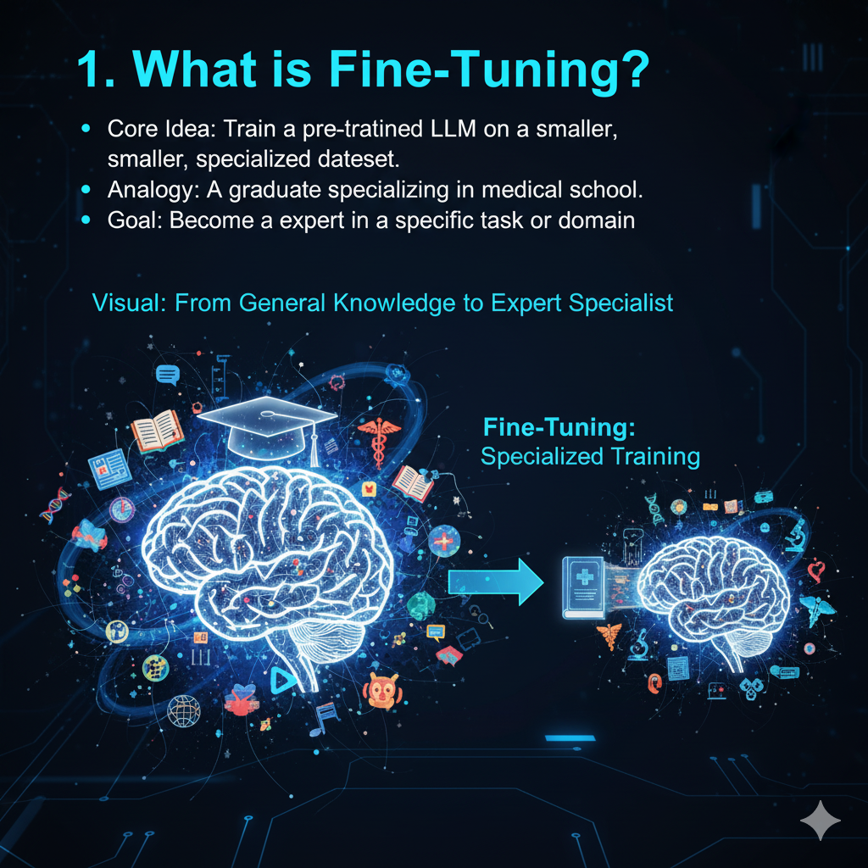
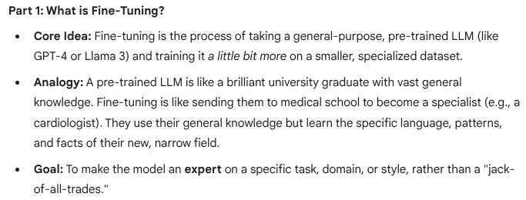
What is fine tuning?

Slide 85
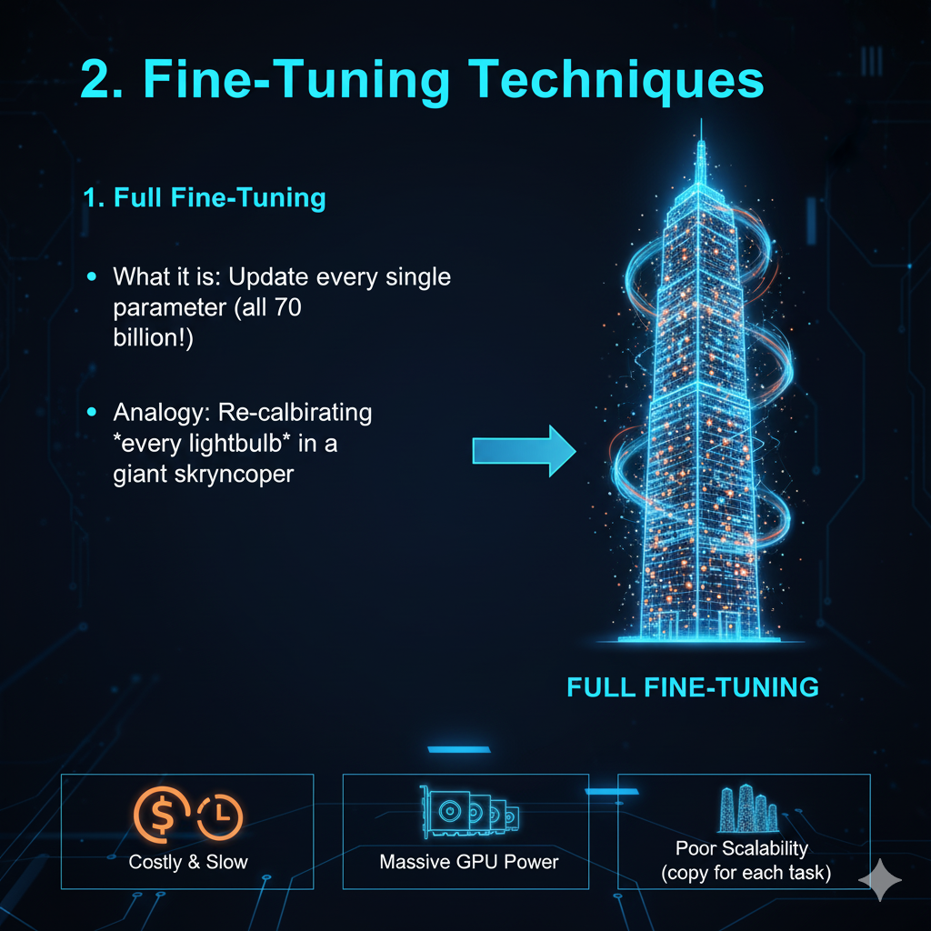
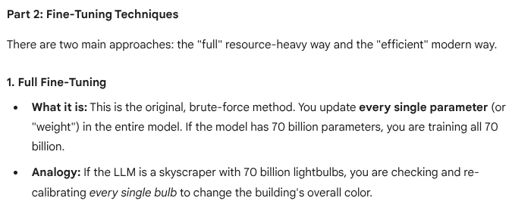
Fine tuning techniques
What are pros and cons of this approach ?

Slide 86
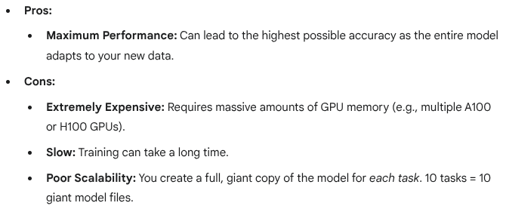
Pros n Cons

Slide 87
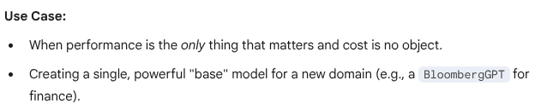
Use cases

Slide 88
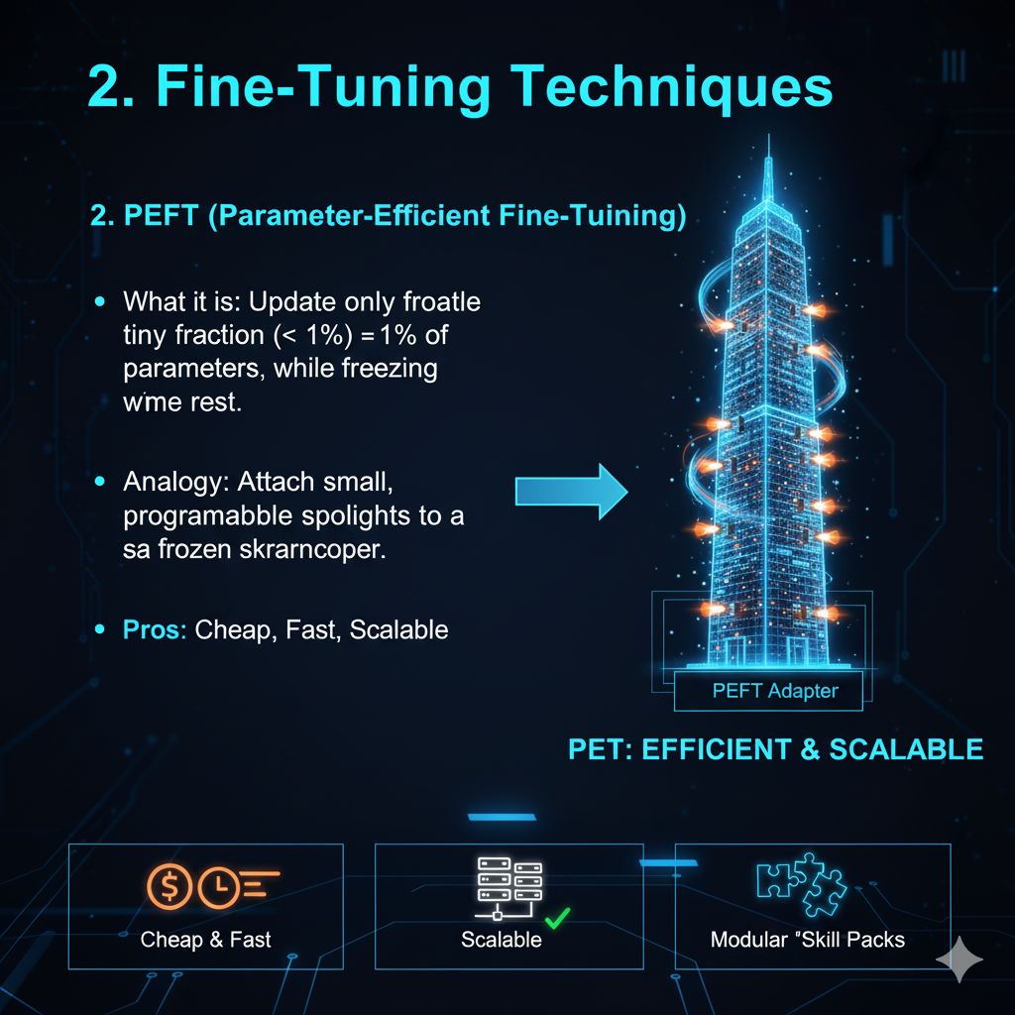
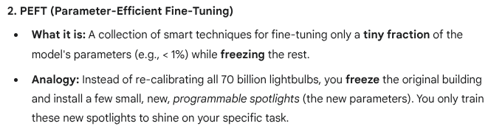
Parameter Efficient fine tuning (PeFT)

Slide 89
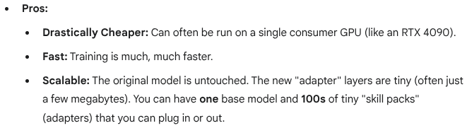
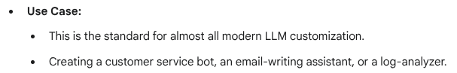
Pros n Use cases

Slide 90
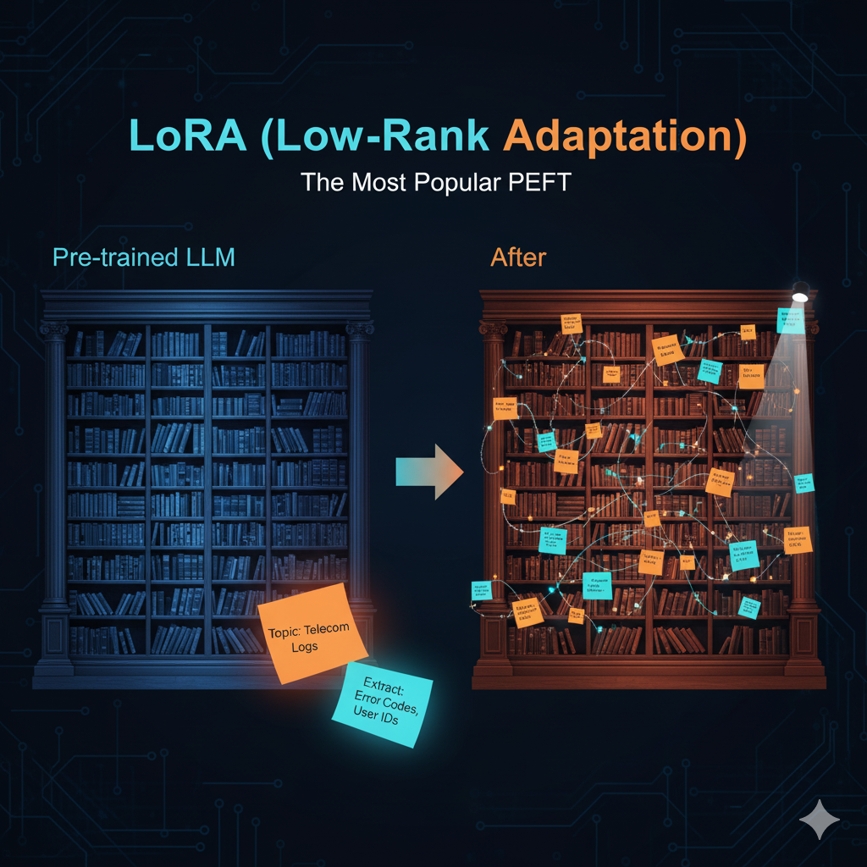
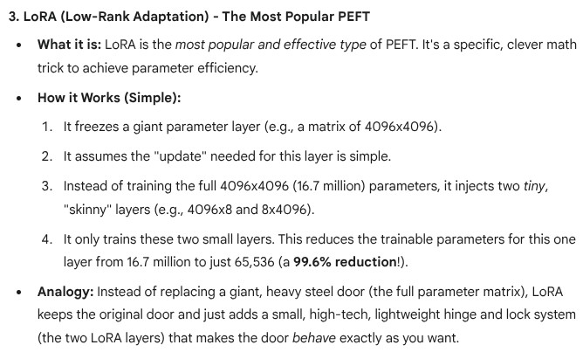
LoRA(Low Rank Adaptation) - Popular PEFT

Slide 91
QnA

